Slide 1
The Kernel Abstraction
Instructor Jianhui Yue
CSE, Miami University
Spring 2017

Slide 2
Main Points
Process concept
A process is the OS abstraction for executing a program with limited privileges
Dual-mode operation: user vs. kernel
Kernel-mode: execute with complete privileges
User-mode: execute with fewer privileges
Safe control transfer
How do we switch from one mode to the other?

Slide 3
Why does an OS have a kernel?
Reliability
Prevent buggy program from causing crashes
Security
Limit the scope of what untrusted programs can do
Privacy
On a multiple-user OS, each user must be limited to only data that the user is permitted to access
Fair resource allocation
OS limit the amount of resource allocated to each app

Slide 4
OS Kernel Implements protection
Apps accesses to hardware are limited
Kernel has full access to all of hardware

Slide 5
Process Abstraction
Process: an instance of a program, running with limited rights
Thread: a sequence of instructions within a process
Potentially many threads per process (for now 1:1)
Address space: set of rights of a process
Memory that the process can access
Other permissions the process has (e.g., which system calls it can make, what files it can access)

Slide 6
Program & Process
A process is an instance of a program execution.
Multiple concurrent executions of a program have multiple process.
OS uses a process control block(PCB) to keep track of the process

Slide 7
Thought Experiment
How can we implement execution with limited privilege?
Execute each program instruction in a simulator
If the instruction is permitted, do the instruction
Otherwise, stop the process
Basic model in Javascript and other interpreted languages
How do we go faster?
Run the unprivileged code directly on the CPU!
Notes:
Upsides? Downsides to this approach? Essentially what you do in Javascript in a browser – simulate the execution of the script, one line at a time.

Slide 8
Hardware Support:
Dual-Mode Operation
Kernel mode
Execution with the full privileges of the hardware
Read/write to any memory, access any I/O device, read/write any disk sector, send/read any packet
User mode
Limited privileges
Only those granted by the operating system kernel
On the x86, mode stored in EFLAGS register
On the MIPS, mode in the status register
Notes:
Obviously, you need the part that has full rights to be really reliable!

Slide 9
A Model of a CPU

Slide 10
A CPU with Dual-Mode Operation
Notes:
Where do interrupts fit in?

Slide 11
Hardware Support:
Dual-Mode Operation
Privileged instructions
Available to kernel
Not available to user code
Limits on memory accesses
To prevent user code from overwriting the kernel
Timer
To regain control from a user program in a loop
Safe way to switch from user mode to kernel mode, and vice versa

Slide 12
Privilege Levels
Some processor functionality cannot be made accessible to untrusted user applications
e.g. HALT, change MMU settings, set clock, reset devices, manipulate device settings, …
Need to have a designated mediator between untrusted/untrusting applications
The operating system (OS)
Need to delineate between untrusted applications and OS code
Use a “privilege mode” bit in the processor
0 = Untrusted = user, 1 = Trusted = OS

Slide 13
Privilege Mode
Privilege mode bit indicates if the current program can perform privileged operations
On system startup, privilege mode is set to 1, and the processor jumps to a well-known address
The operating system (OS) boot code resides at this address
The OS sets up the devices, initializes the MMU, loads applications, and resets the privilege bit before invoking the application
Applications must transfer control back to OS for privileged operations

Slide 14
What should happen if a user program attempts to execute a privileged instruction?
Change mode bit in EFLAGs register!
Change which memory locations a user program can access
Send commands to I/O devices
Read data from/write data to I/O devices
Jump into kernel code
…

Slide 15
Question
For a “Hello world” program, the kernel must copy the string from the user program memory into the screen memory.
Why not allow the application to write directly to the screen’s buffer memory?

Slide 16
Simple Memory Protection
To make memory sharing safe, OS must configure the hardware to limit each process memory access to its boundary.
Notes:
Second thing

Slide 17
Towards Virtual Addresses
Problems with base and bounds?
Expandable heap?
Expandable stack?
Memory sharing between processes?
Non-relative addresses – hard to move memory around
Memory fragmentation
Notes:
Expandable heap?
Expandable stack?
Memory sharing between processes?
Non-relative addresses – hard to move memory around
Memory fragmentation

Slide 18
Virtual Addresses
Translation done in hardware, using a table
Table set up by operating system kernel
Notes:
On every instruction!
Table of instructions set up by the kernel: similar idea to buffer descriptor queue for I/O

Slide 19
Example
int staticVar = 0; // a static variable
main() {
staticVar += 1;
sleep(10); // sleep for x seconds
printf ("static address: %x, value: %d\n", &staticVar,
staticVar);
}
What happens if we run two instances of this program at the same time?
What if we took the address of a procedure local variable in two copies of the same program running at the same time?
Notes:
Because of stack address munging on modern systems (to prevent viruses), if you use a procedure local variable, won’t get the same result – different addresses used by different instances

Slide 20
Question
With an object-oriented language and compiler, only an object’s methods can access the internal data inside an object. If the operating system only ran programs written in that language, would it still need hardware memory address protection?
What if the contents of every object were encrypted except when its method was running, including the OS?

Slide 21
Kernel regains control from running process
User wants to stop running apps
OS needs to switch to a new task
How to make the running process yield CPU control to other one?
General mechanism is interrupt.
On interrupt occurring, the hardware transfers control from the user process to the kernel.

Slide 22
Hardware Timer
Hardware device that periodically interrupts the processor
Returns control to the kernel handler
Interrupt frequency set by the kernel
Not by user code!
Interrupts can be temporarily deferred
Not by user code!
Interrupt deferral crucial for implementing mutual exclusion
Notes:
How do I stop a runaway program? How do I know if a runaway program needs to be stopped, or its just taking a long time?

Slide 23
What causes execution switch to the kernel?
Interrupt( by external events)
Occur asynchronously
Transfer control to kernel
Processor exception (by CPU execution)
Trap( synch. transfer control to kernel)
System call(by CPU execution)
They are driving force to OS

Slide 24
Interrupts
An interrupt is an asynchronous signal to the processor that some external event has occurred to require its handling.
Stall executing instruction and start to execute interrupt handler
Hardware stores states
Handler implemented by software
Interrupt informs the kernel the completion of IO.
Notes:
OK, a quick tour of I/O. Without I/O, can’t do much of anything!

Slide 25
Interrupt Illustrated
User Mode
Mode bit = 1
User
process
Resume process
Kernel Mode
Mode bit = 0
Return
Mode bit = 1
Suspend user process
Execute OS’s interrupt handler
Save user process’s state
Execute device driver
Restore
state
Clear
interrupt
Device
Raise
Interrupt

Slide 26
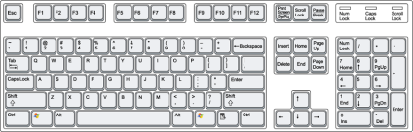
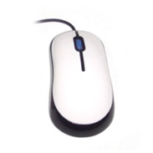

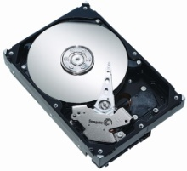
Interrupt Driven I/O
Memory
Interrupt
Controller
CPU
intr
dev id
An interrupt controller mediates between competing devices
Raises an interrupt flag to get the CPU’s attention
Identifies the interrupting device
Can disable (aka mask) interrupts if the CPU so desires

Slide 27
Polling vs. Interrupts
The CPU constantly needs to read the keyboard latch memory location to see if a key is pressed
Called polling
Inefficient
Interrupt driven I/O enables the CPU and devices to perform tasks concurrently, increasing throughput
Only needs a tiny bit of circuitry and a few extra wires to implement the “alert” operation

Slide 28
Processor Exception
Hardware event caused by user program execution
Sometimes, need to transfer control to the OS at a time when the user program least expects it
Division by zero,
Alert from the power supply that electricity is about to go out,
Alert from the network device that a packet just arrived,
Clock notifying the processor that the clock just ticked,
Some of these causes for interruption of execution have nothing to do with the user application

Slide 29
System Call
A system call is any procedure provided by kernel that can be called from user level.
Implemented by trap/syscall instruction
The execution of system changes processor mode from user mode to kernel mode and executed the pre-defined procedure in kernel
Examples of System call
Create a file, read/write a file, …

Slide 30
Terminology
Trap
Any kind of a control transfer to the OS
Syscall
Synchronous, program-initiated control transfer from user to the OS to obtain service from the OS
e.g. SYSCALL
Exception
Asynchronous, program-initiated control transfer from user to the OS in response to an exceptional event
e.g. Divide by zero, segmentation fault
Interrupt
Asynchronous, device-initiated control transfer from user to the OS
e.g. Clock tick, network packet

Slide 31
Mode Switch(User->Kernel)
From user mode to kernel mode
Interrupts
Triggered by timer and I/O devices
Exceptions
Triggered by unexpected program behavior
Or malicious behavior!
System calls (aka protected procedure call)
Request by program for kernel to do some operation on its behalf
Only limited # of very carefully coded entry points
Notes:
Might work better starting with interrupts!

Slide 32
Mode Switch (Kernel ->User)
From kernel mode to user mode
New process/new thread start
Jump to first instruction in program/thread
Return from interrupt, exception, system call
Resume suspended execution
Process/thread context switch
Resume some other process
Context switch( Save/restore context)
User-level upcall (UNIX signal)
Asynchronous notification to user program

Slide 33
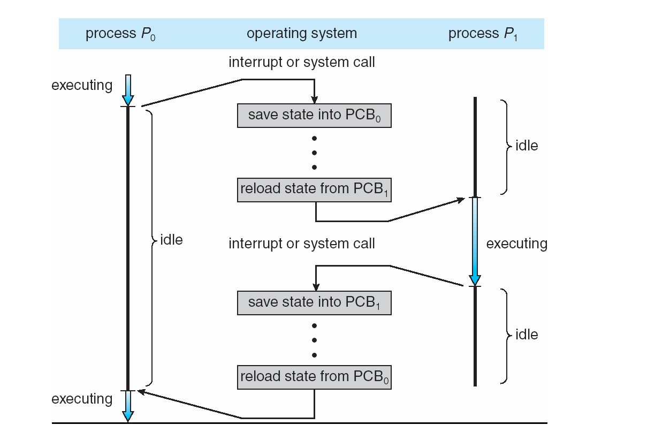
CPU Switch From Process to Process

Slide 34
How do we take interrupts safely?
Interrupt vector
Limited number of entry points into kernel
Atomic transfer of control
The followings are changed at same time:
Program counter
Stack pointer
Memory protection
Kernel/user mode
Transparent restartable execution
User program does not know interrupt occurred

Slide 35
Interrupt Vector
Table set up by OS kernel; pointers to code to run on different events
Notes:
Note: by “processor register” I do not mean %eax. Rather – these are special purpose registers.

Slide 36
Why Kernel Stack?
Can we the user-level to states for interrupt handling?
Reliability
Process’s stack pointer might not be valid
Security
Return address can be modified

Slide 37
Kernel Stack
Interrupt stack a special memory region for the interrupt context switch and kernel procedure calls.
On an interrupt, hardware saves info to interrupt stack and handler saves other to the stack.
Before returning, handler restores the interrupted process’ states
Why can’t the interrupt handler run on the stack of the interrupted user process?
Notes:
What goes in a stack frame?
Frame pointer
Locals
Return address

Slide 38
Two Stacks per Process
Each user-level process has both user-level stack and kernel stack.
On an interrupt, hardware saves info to interrupt stack and handler saves other to the stack.
Before returning, handler restores the interrupted process’ states
Notes:
What goes in a stack frame?
Frame pointer
Locals
Return address

Slide 39
Two Stacks facilitate context switch inside kernel
A
B
C
A: process is running in user-level, kernel stack is empty
B: Kernel switches the currently interrupted process to the other after handling the interrupt
C: Kernel is waiting for I/O completion
Kernel stack holds the context to be resumed when I/O is done
Notes:
Lots of complexity on this slide. Let’s unpack:
Every process/thread has two stacks. When the process is running, does the kernel stack have anything useful on it? You might think yes – it called into the user program. But actually no – the user program doesn’t return from main.
Need to change this to add “crt0.s” – main returns to crt0.s, and then calls exit.
Best to think of this as multiple personality disorder: sometimes we want to save context, other times not!
When a process is ready to run, but not running – it has its user stack as before, but now I also need a place to store the state that had been in the CPU when it stopped running
When a process is waiting for I/O, it had done a system call, etc.

Slide 40
Interrupt Masking
Interrupt handler runs with interrupts off
Re-enabled when interrupt completes
OS kernel can also turn interrupts off
Eg., when determining the next process/thread to run
On x86
CLI: disable interrrupts
STI: enable interrupts
Only applies to the current CPU (on a multicore)
We’ll need this to implement synchronization in chapter 5

Slide 41
Interrupt Handlers
Non-blocking, run to completion
Minimum necessary to allow device to take next interrupt
Any waiting must be limited duration
Wake up other threads to do any real work
Linux: semaphore
Rest of device driver runs as a kernel thread
Notes:
Skip this slide – too much for the students to get

Slide 42
Case Study: x86 Interrupt
Save current stack pointer
Save current program counter
Save current processor status word (condition codes)
Switch to kernel stack; put SP, PC, PSW on stack
Switch to kernel mode
Vector through interrupt table
Interrupt handler saves registers it might clobber

Slide 43
HW Support -Before Interrupt
Notes:
Why does the stack pointer on the x86 have two components?

Slide 44
HW Support -During Interrupt

Slide 45
Question
Why is the stack pointer saved twice on the interrupt stack?
Hint: is it the same stack pointer?

Slide 46
At end of handler
Handler restores saved registers
Atomically return to interrupted process/thread
Restore program counter
Restore program stack
Restore processor status word/condition codes
Switch to user mode

Slide 47
HW Support -After Interrupt

Slide 48
Stub Pair for System Call

Slide 49
Kernel System Call Handler
Locate arguments
In registers or on user stack
Translate user addresses into kernel addresses
Copy arguments
From user memory into kernel memory
Protect kernel from malicious code evading checks
Validate arguments
Protect kernel from errors in user code
Copy results back into user memory
Translate kernel addresses into user addresses

Slide 50
User-level system call stub
// We assume that the caller put the filename onto the stack,
// using the standard calling convention for the x86.
open:
// Put the code for the system call we want into %eax.
movl #SysCallOpen, %eax
// Trap into the kernel.
int #TrapCode
// Return to the caller; the kernel puts the return value in %eax.
ret

Slide 51
Kernel-level system call stub
int KernelStub_Open() {
char *localCopy[MaxFileNameSize + 1];
// Check that the stack pointer is valid and that the arguments are stored at valid addresses.
if (!validUserAddressRange(userStackPointer, userStackPointer + size of arguments))
return error_code;
// Fetch pointer to file name from user stack and convert it to a kernel pointer.
filename = VirtualToKernel(userStackPointer);
// Make a local copy of the filename. This prevents the application from changing the name surreptitiously.
// The string copy needs to check each address in the string before use to make sure it is valid.
// The string copy terminates after it copies MaxFileNameSize to ensure we
// do not overwrite our internal buffer.
if (!VirtualToKernelStringCopy(filename, localCopy, MaxFileNameSize))
return error_code;
// Make sure the local copy of the file name is null terminated. localCopy[MaxFileNameSize] = 0;
// Check if the user is permitted to access this file.
if (!UserFileAccessPermitted(localCopy, current_process)
return error_code;
// Finally, call the actual routine to open the file. This returns a file
// handle on success, or an error code on failure.
return Kernel_Open(localCopy); }

Slide 52
Create A Process
Allocate and initialize the process control block
Allocate memory for the process
Copy executable image to memory
Allocate user-level stack
Allocate kernel-level stack
Start A Process
Copy arguments to user memory
Transfer control to user mode

Slide 53
Upcall: User-level event delivery
Notify user process of some event that needs to be handled right away
Time expiration
Real-time user interface
Time-slice for user-level thread manager
Interrupt delivery for VM player
Asynchronous I/O completion (async/await)
AKA UNIX signal

Slide 54
Upcalls vs Interrupts
Signal handlers = interrupt vector
Signal stack = interrupt stack
Automatic save/restore registers = transparent resume
Signal masking: signals disabled while in signal handler

Slide 55
Upcall: Before

Slide 56
Upcall: During

Slide 57
User-Level Virtual Machine
How does VM Player work?
Runs as a user-level application
How does it catch privileged instructions, interrupts, device I/O?
Installs kernel driver, transparent to host kernel
Requires administrator privileges!
Modifies interrupt table to redirect to kernel VM code
If interrupt is for VM, upcall
If interrupt is for another process, reinstalls interrupt table and resumes kernel

Slide 58
Notes:
Apologies: it should be Guest/Host Interrupt Stack to be consistent with the other figures.

